Slide 1
Data Grid View

Slide 2
DATA RETRIEVAL FROM DATABASE
Manually displaying table records without DataGrid View
Create one WebForm having one Button. After clicking button all the records should be displayed on the web Form

Slide 3
protected void Button1_Click(object sender, EventArgs e)
{
SqlConnection conn = new SqlConnection(ConfigurationManager.ConnectionStrings["ConnectionString"].ConnectionString);
conn.Open();
Console.WriteLine("Connection Open ! ");
string sql = "select * from student";
SqlCommand cmd = new SqlCommand(sql, conn);
SqlDataReader sdr = cmd.ExecuteReader();
Response.Write("ID\tName\tSem\tCity"+"<br>");
////Retrieve data from table and Display result
while (sdr.Read())
{
Response.Write(sdr["id"] + "&nbsp;" + sdr["name"]+ "&nbsp; " + sdr["sem"]+ "&nbsp; " + sdr["city"]+"<br>");
//Console.WriteLine(sdr["name"]);
}
conn.Close();
}

Slide 4
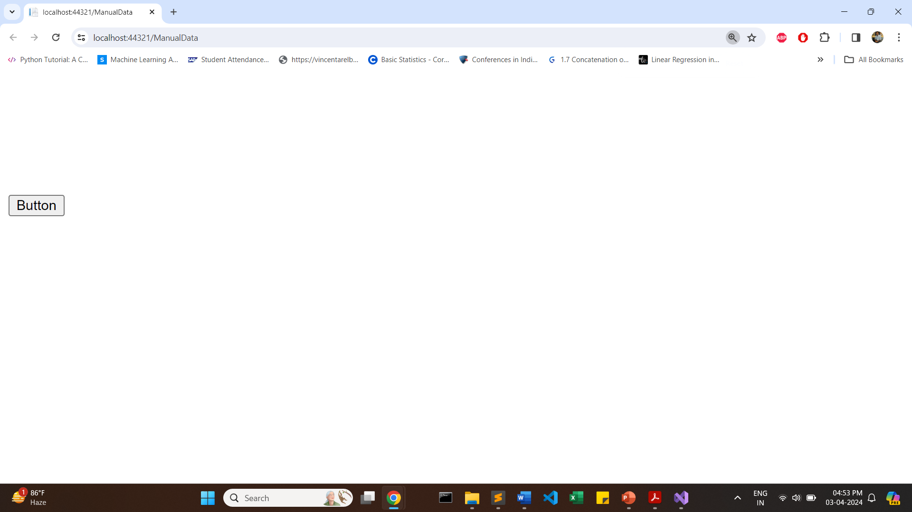

Slide 5
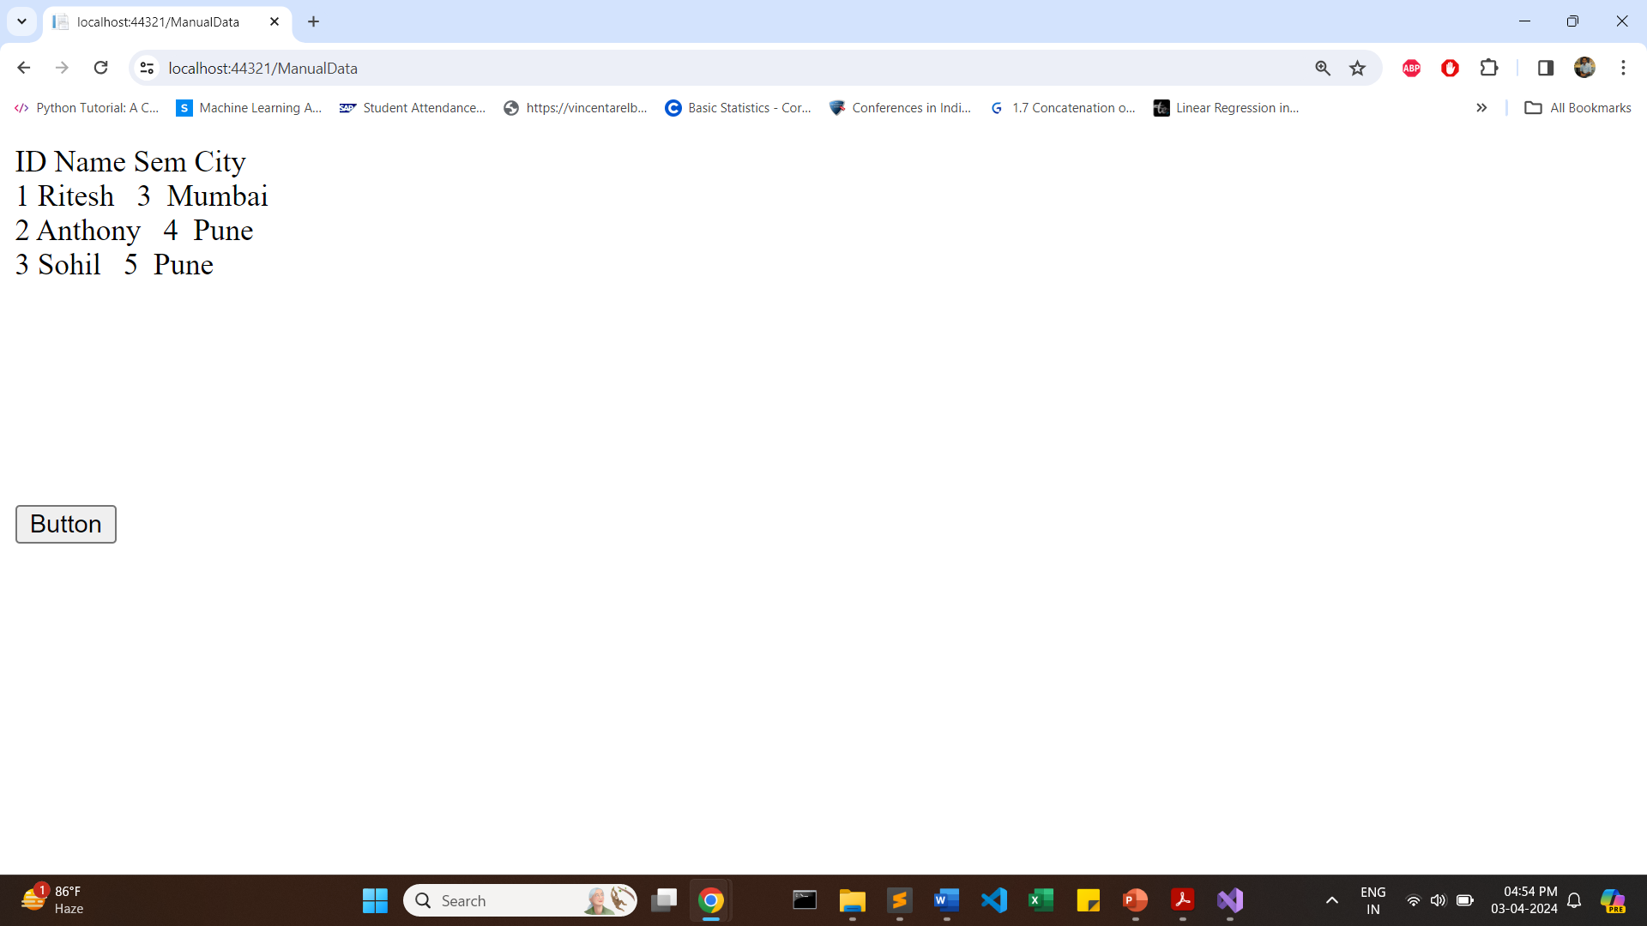

Slide 6
Using Data Grid View

Slide 7
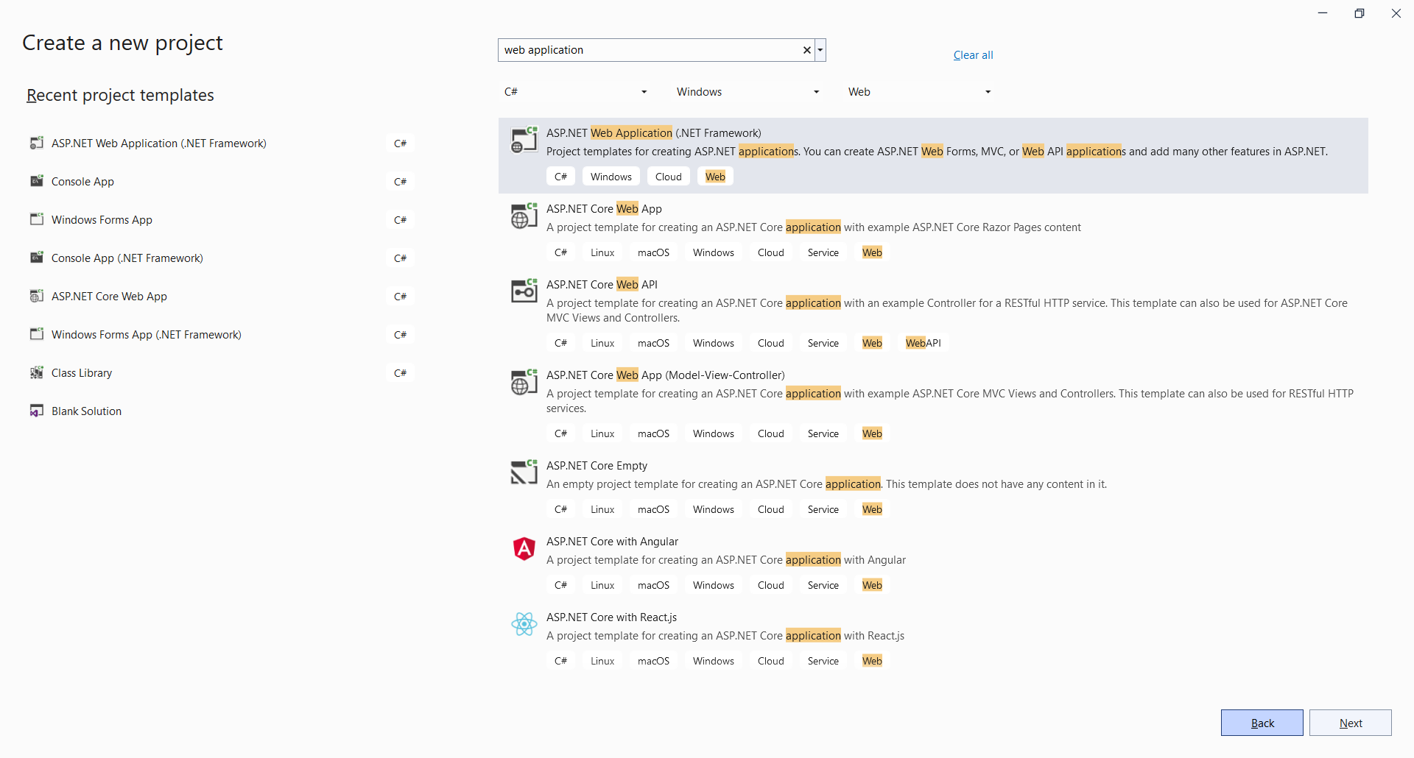

Slide 8
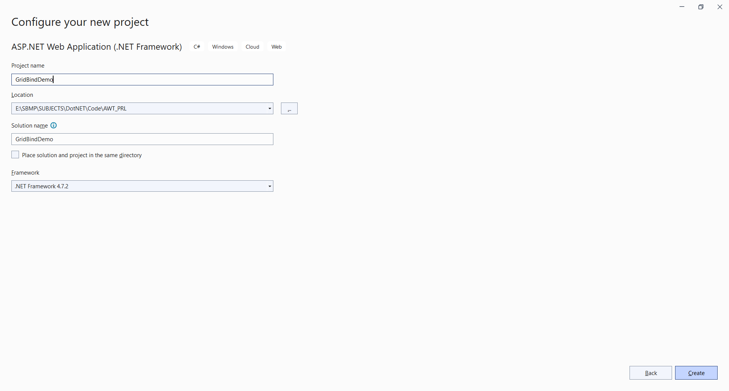

Slide 9
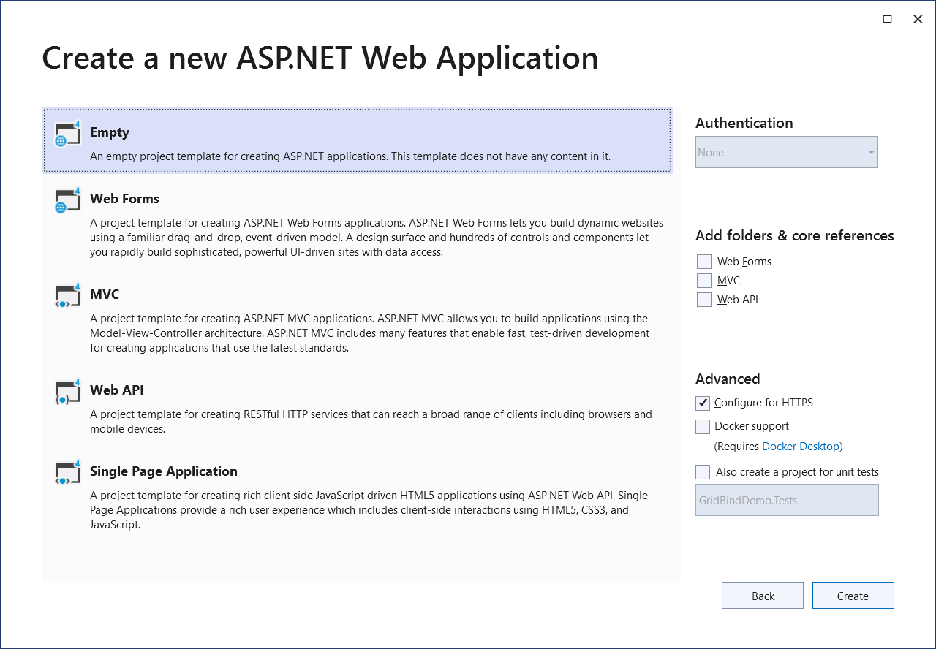

Slide 10
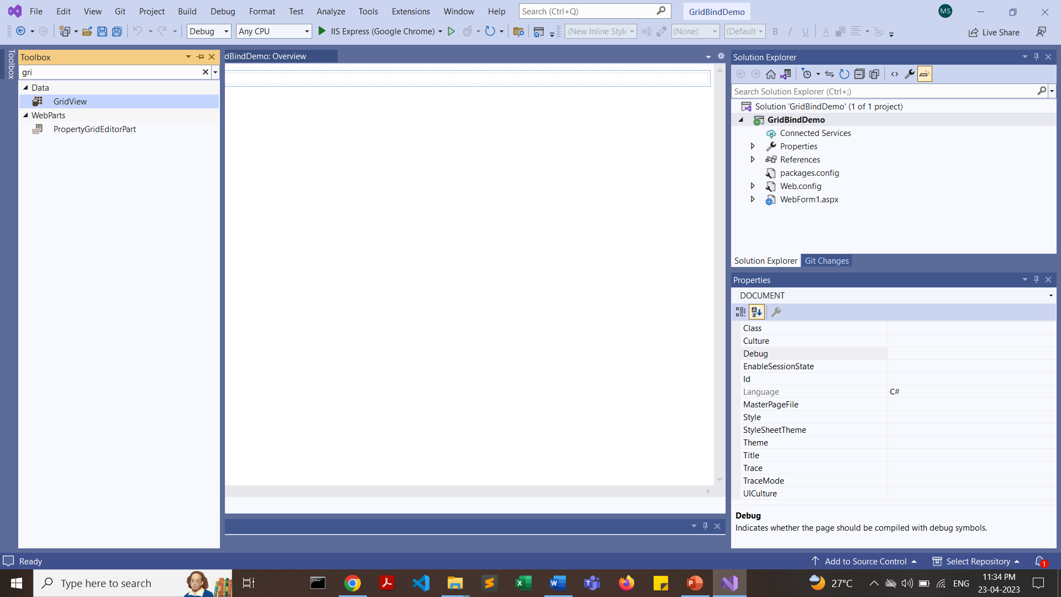
Select the “GridView” tool from toolbox

Slide 11
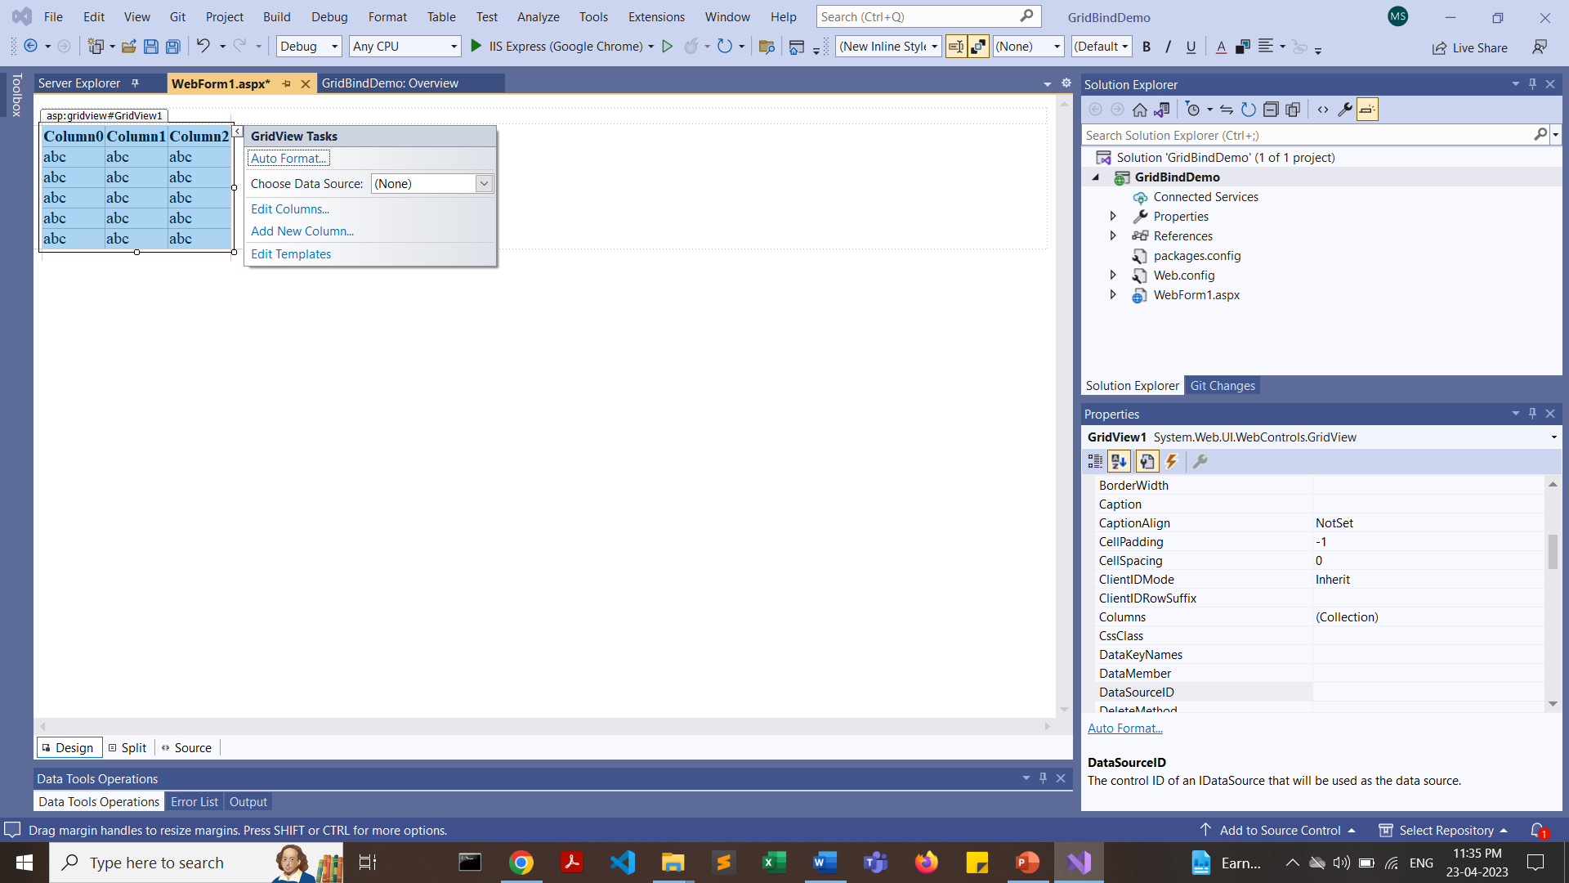
Now add a button from toolbox

Slide 12
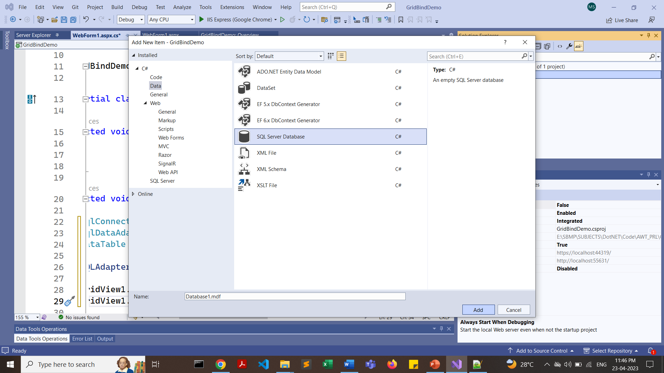

Slide 13
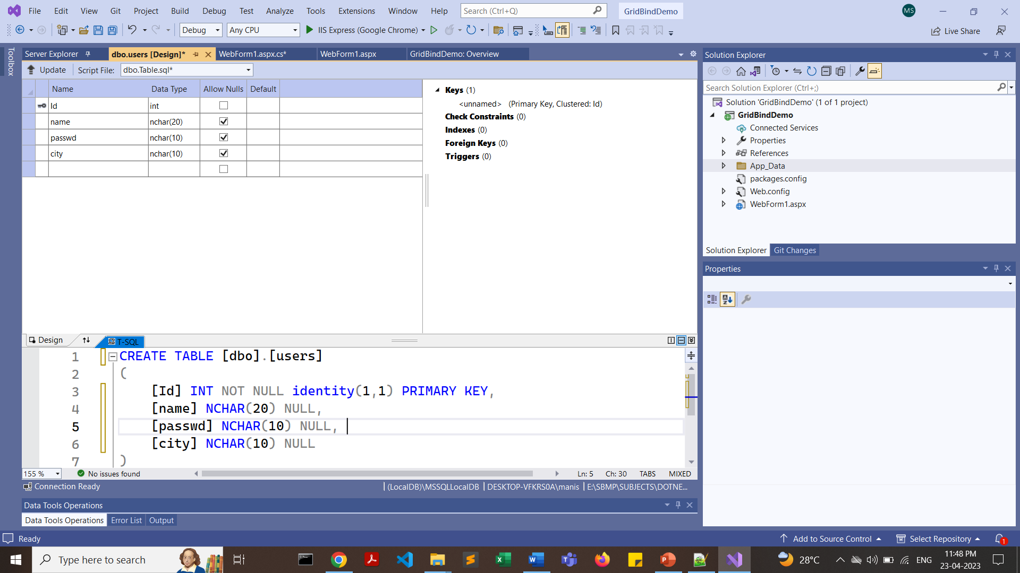

Slide 14
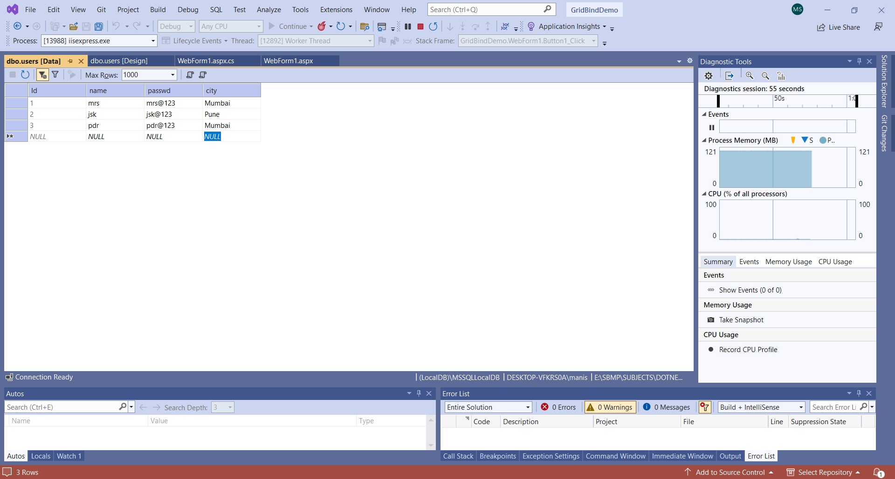

Slide 15
From Toolbox select “DataSource” and add it to the form. Configure DataSource and attach it with data table (as we had done in earlier experiment)

Slide 16
<html xmlns="http://www.w3.org/1999/xhtml">
<head runat="server">
<title></title>
</head>
<body>
<form id="form1" runat="server">
<div>
</div>
<asp:GridView ID="GridView1" runat="server">
</asp:GridView>
<asp:Button ID="Button1" runat="server" OnClick="Button1_Click" Text="Button" />
<asp:SqlDataSource ID="SqlDataSource2" runat="server" ConnectionString="<%$ ConnectionStrings:ConnectionString %>" SelectCommand="SELECT [name], [passwd], [city] FROM [users]"></asp:SqlDataSource>
</form>
</body>
</html>

Slide 17
using System;
using System.Collections.Generic;
using System.Linq;
using System.Web;
using System.Web.UI;
using System.Web.UI.WebControls;
using System.Data.SqlClient;
using System.Data;
using System.Drawing;
using System.Configuration;

Slide 18
protected void Button1_Click(object sender, EventArgs e)
{
SqlConnection con = new SqlConnection(ConfigurationManager.ConnectionStrings["ConnectionString"].ConnectionString);
SqlDataAdapter sde = new SqlDataAdapter("Select * from users", con);
DataSet ds = new DataSet();
sde.Fill(ds);
GridView1.DataSource = ds;
GridView1.DataBind();
}

Slide 19
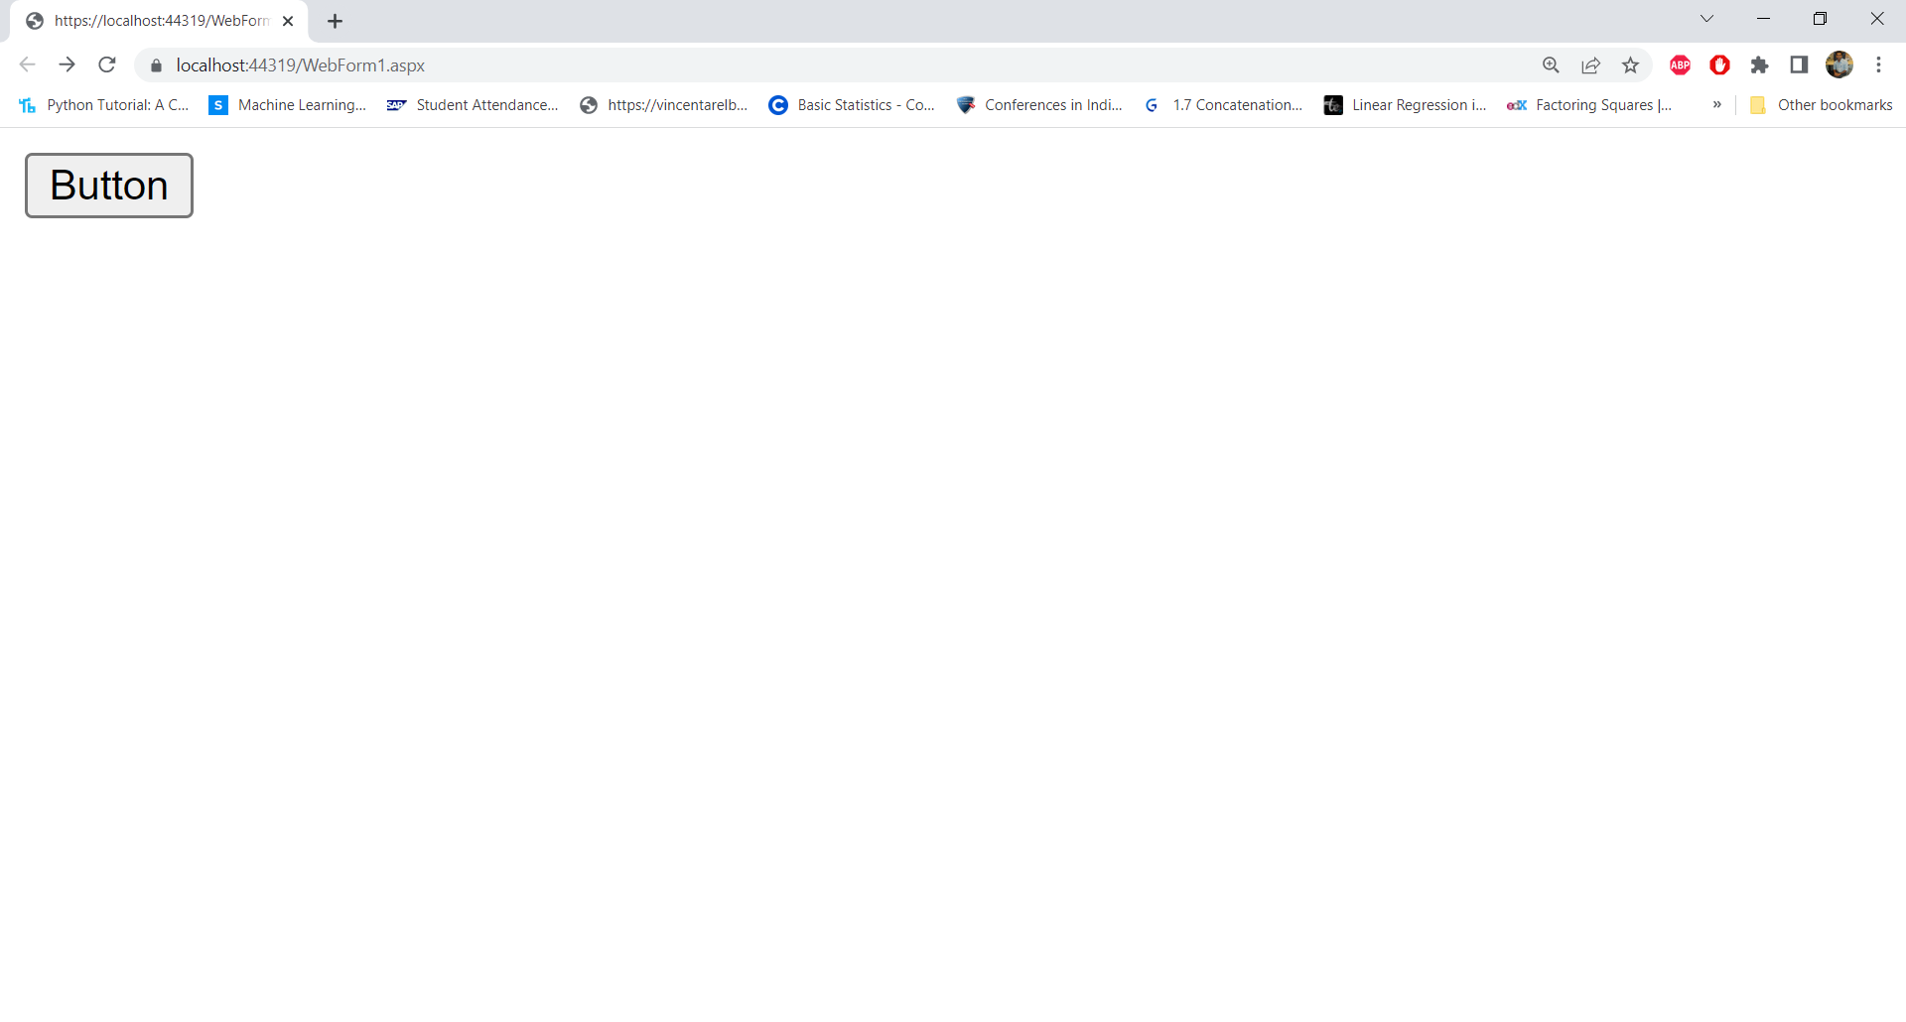

Slide 20
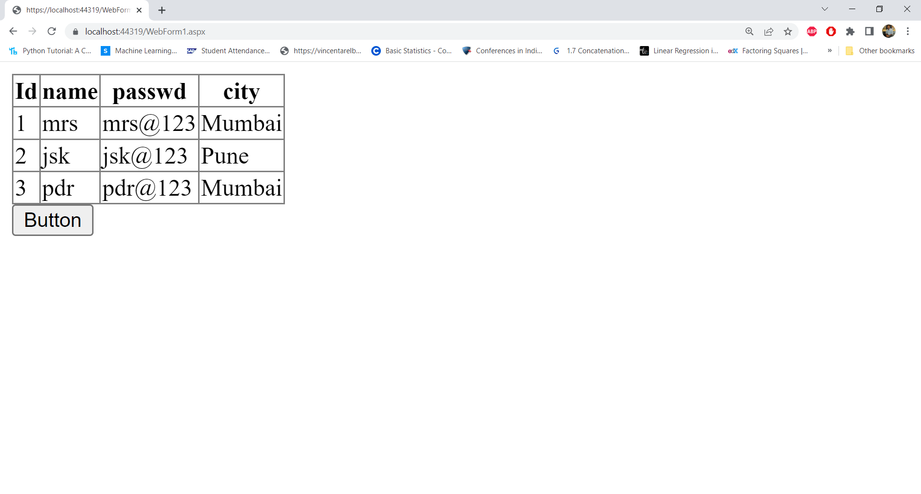

Slide 21
DATA RETRIEVAL FROM DATABASE
Manually displaying table records without DataGrid View

Slide 22
using System;
using System.Collections.Generic;
using System.Configuration;
using System.Data.SqlClient;
using System.Linq;
using System.Web;
using System.Web.UI;
using System.Web.UI.WebControls;

Slide 23
protected void Button1_Click(object sender, EventArgs e)
{
SqlConnection conn = new SqlConnection(ConfigurationManager.ConnectionStrings["ConnectionString"].ConnectionString);
conn.Open();
Console.WriteLine("Connection Open ! ");
string sql = "select * from users";
SqlCommand cmd = new SqlCommand(sql, conn);
SqlDataReader sdr = cmd.ExecuteReader();
////Retrieve data from table and Display result
while (sdr.Read())
{
Console.WriteLine(sdr["name"]);
Response.Write(sdr["name"]);
}
conn.Close();
}
}
}

